Slide 1
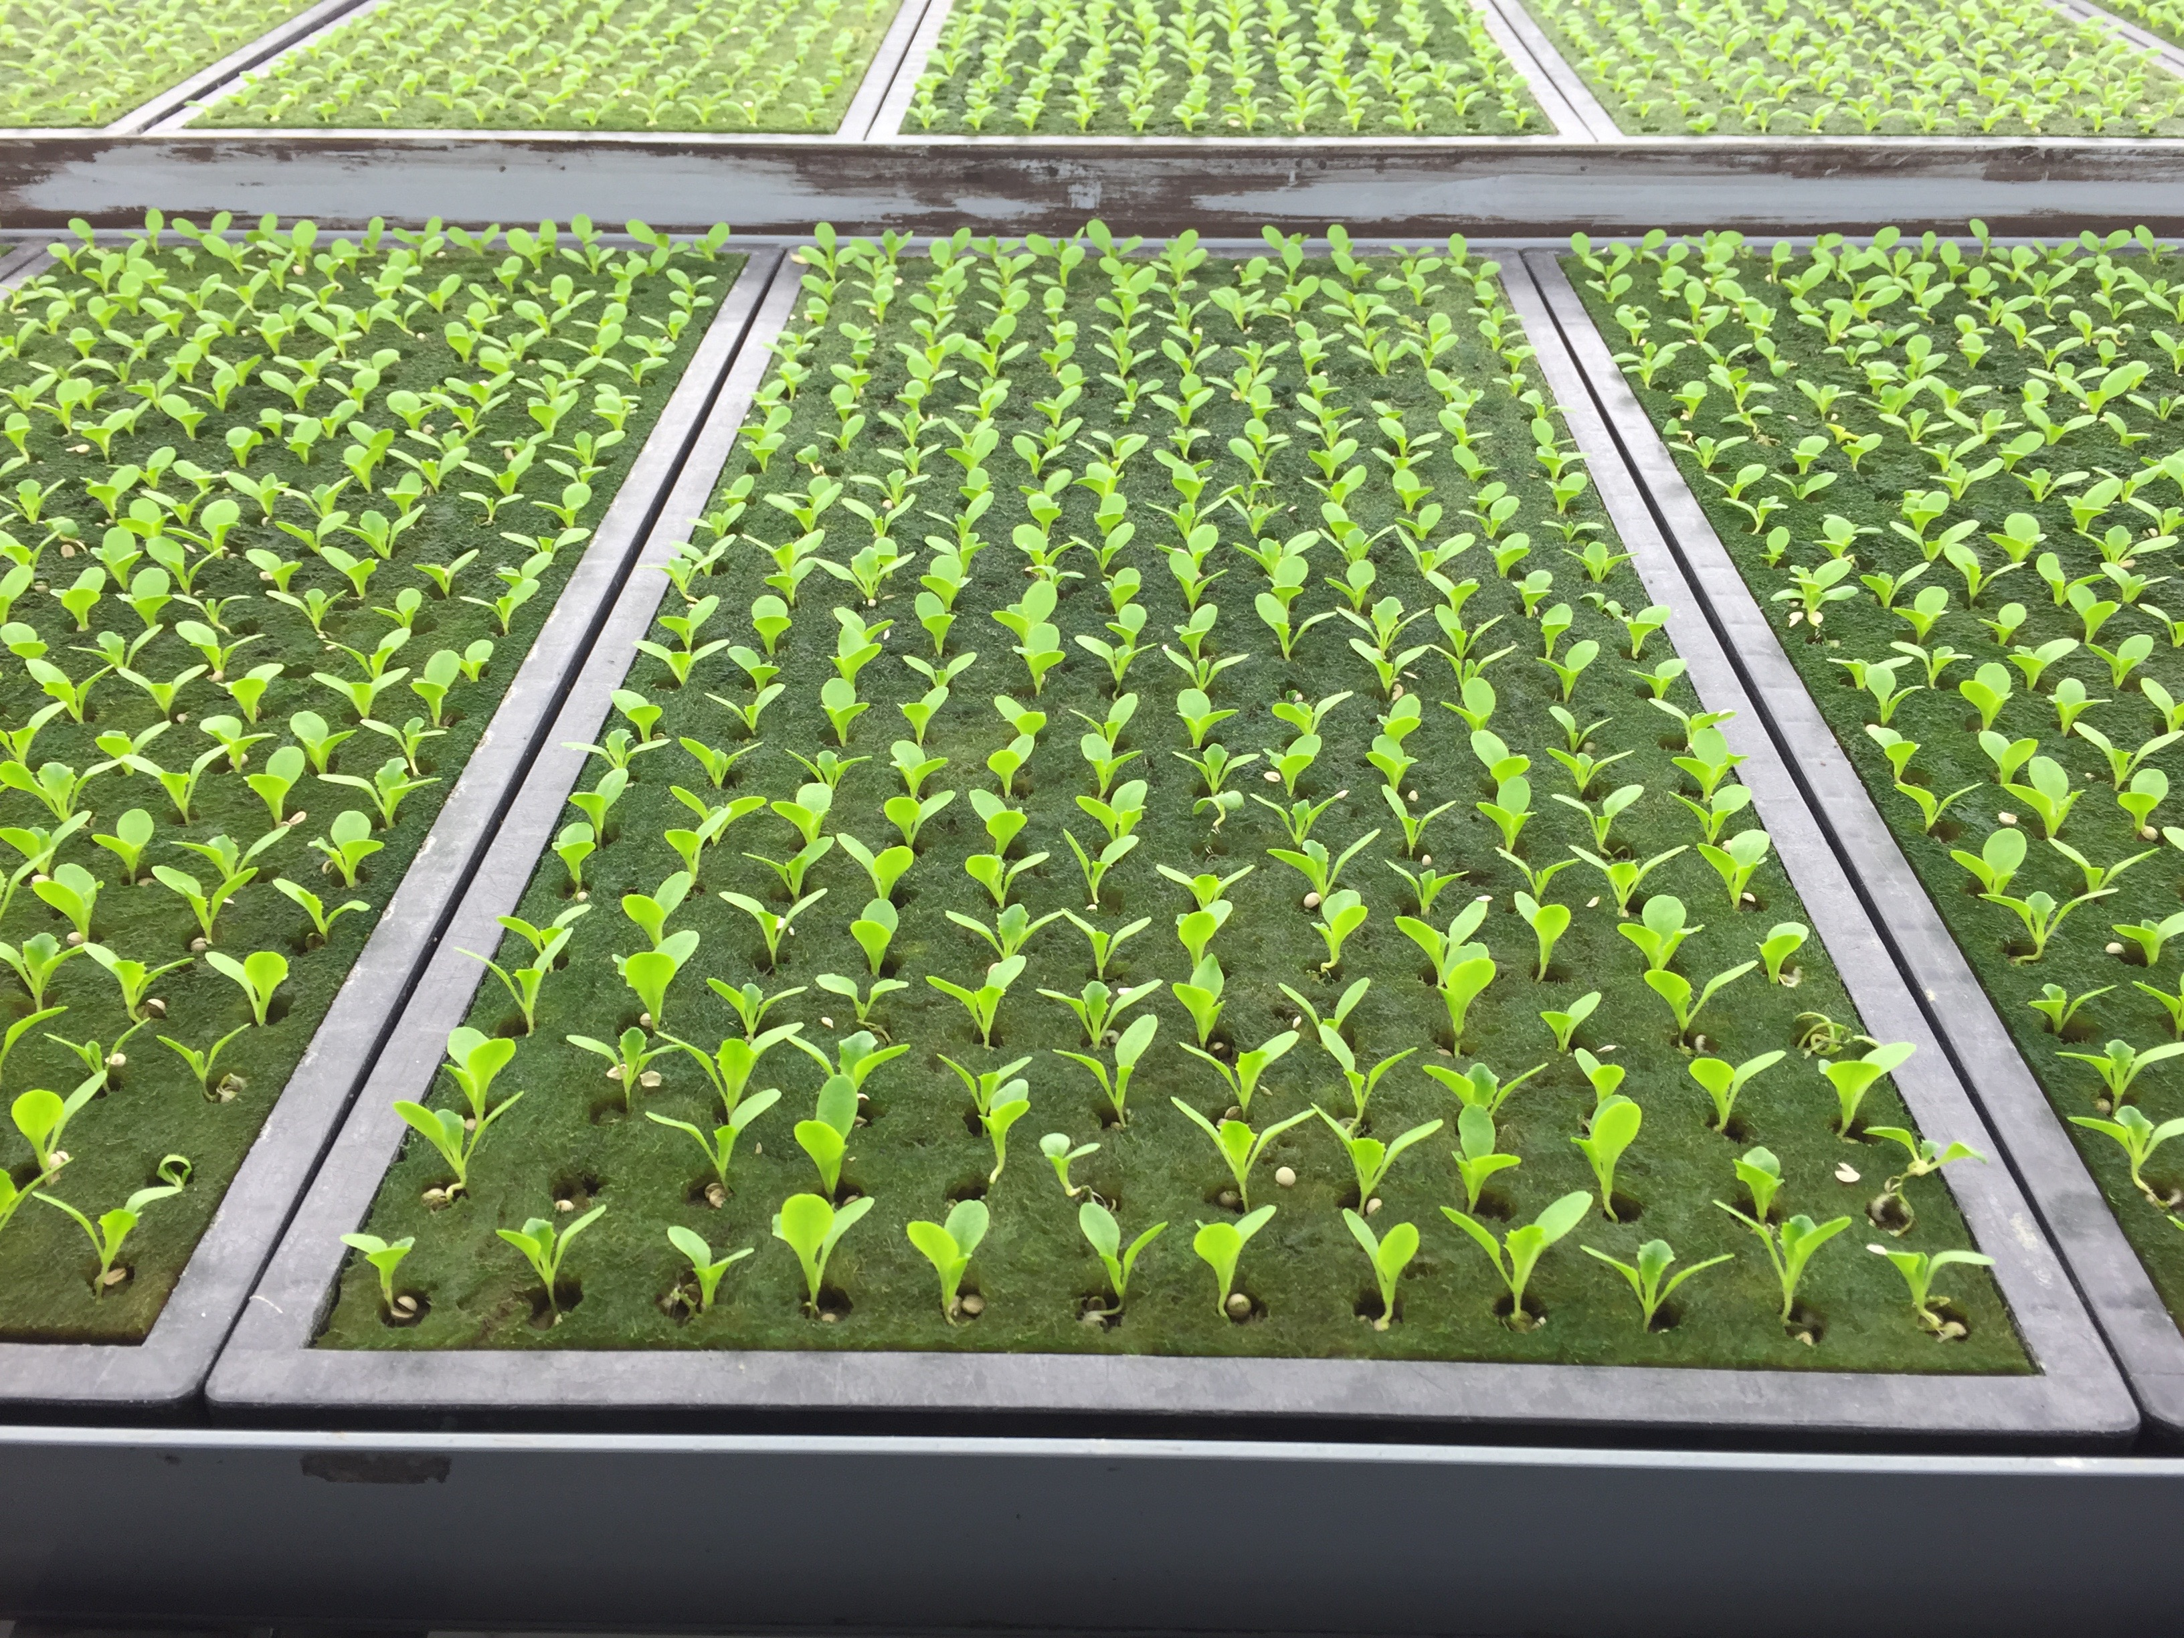


Urban Agriculture Value Chain Mapping Final Training/
Handover

Slide 2
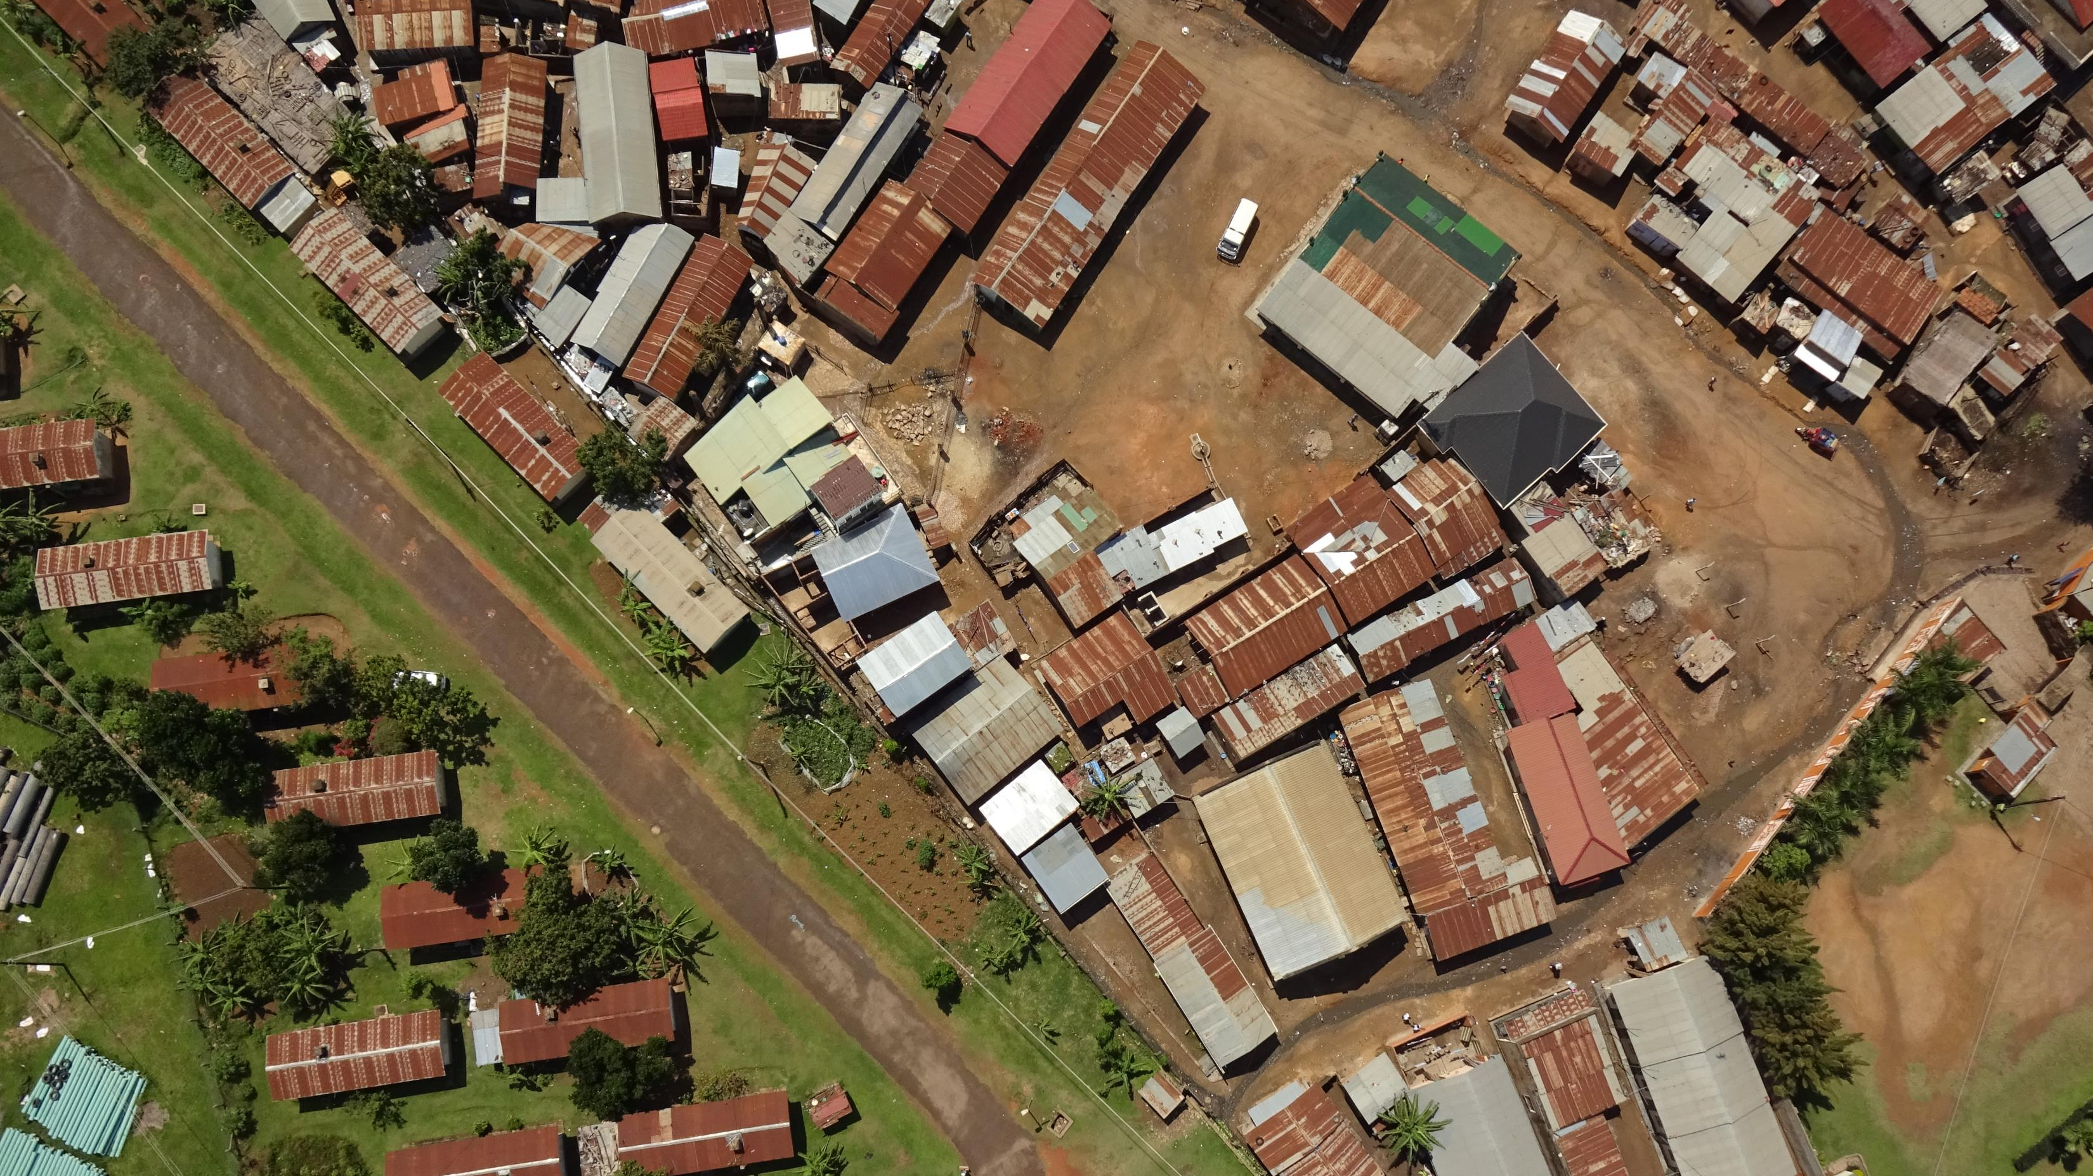
Agenda
1. Deliverables
Project report
Portal, use and functionality
2. Data flow, field collection → Excel → portal
3. Data structure
4. Way forward (2019 and beyond)
- Portal hosting (github → KCCA)
- 2019 and beyond

Slide 3

Deliverables

Slide 4


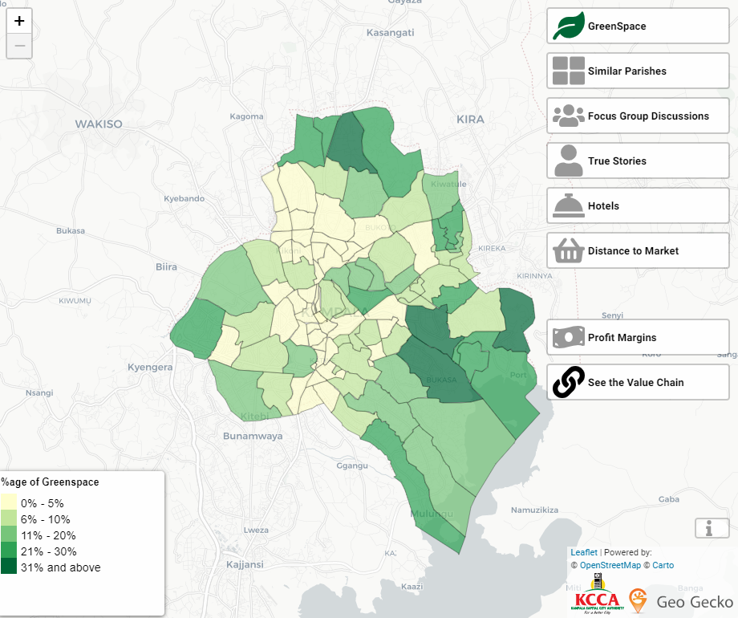

Slide 5



Data flow
→ →

Slide 7

Data structure

Slide 8

Way forward (2019 and beyond)

Slide 9
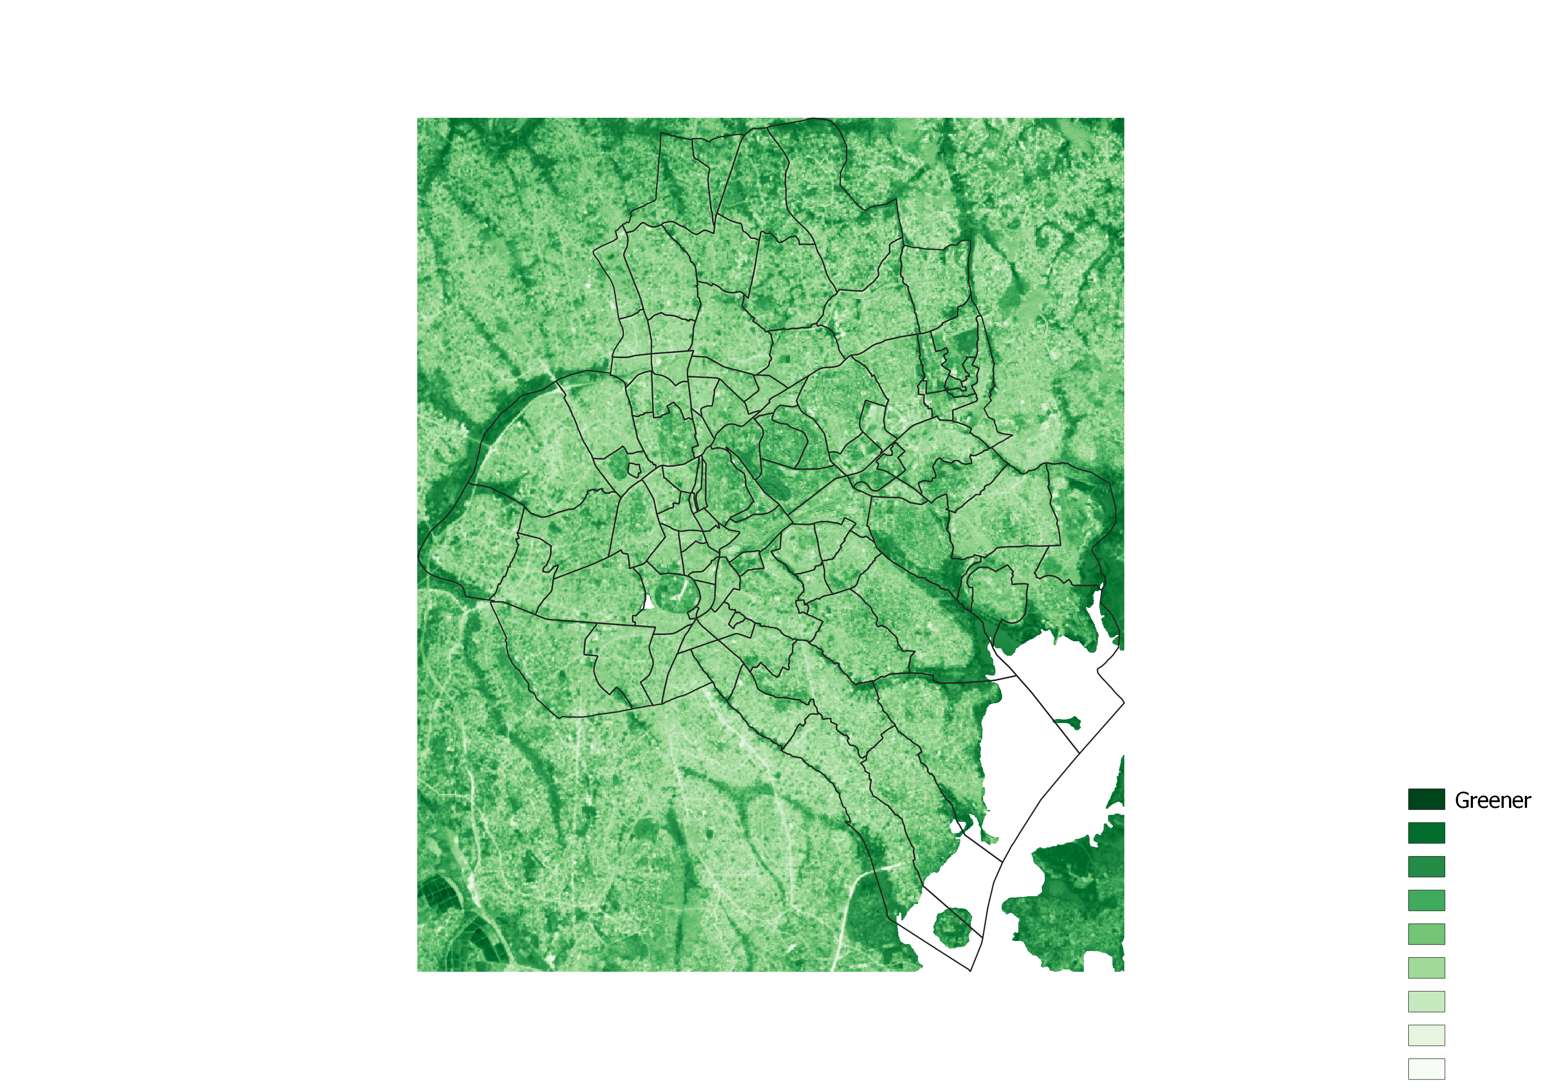
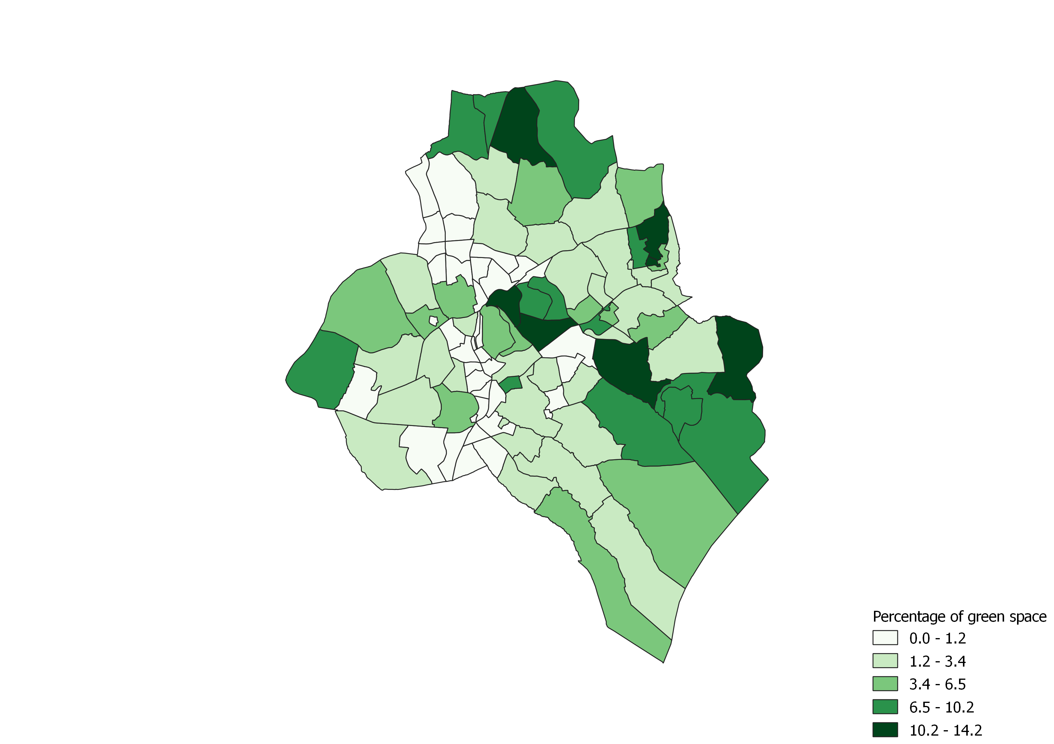
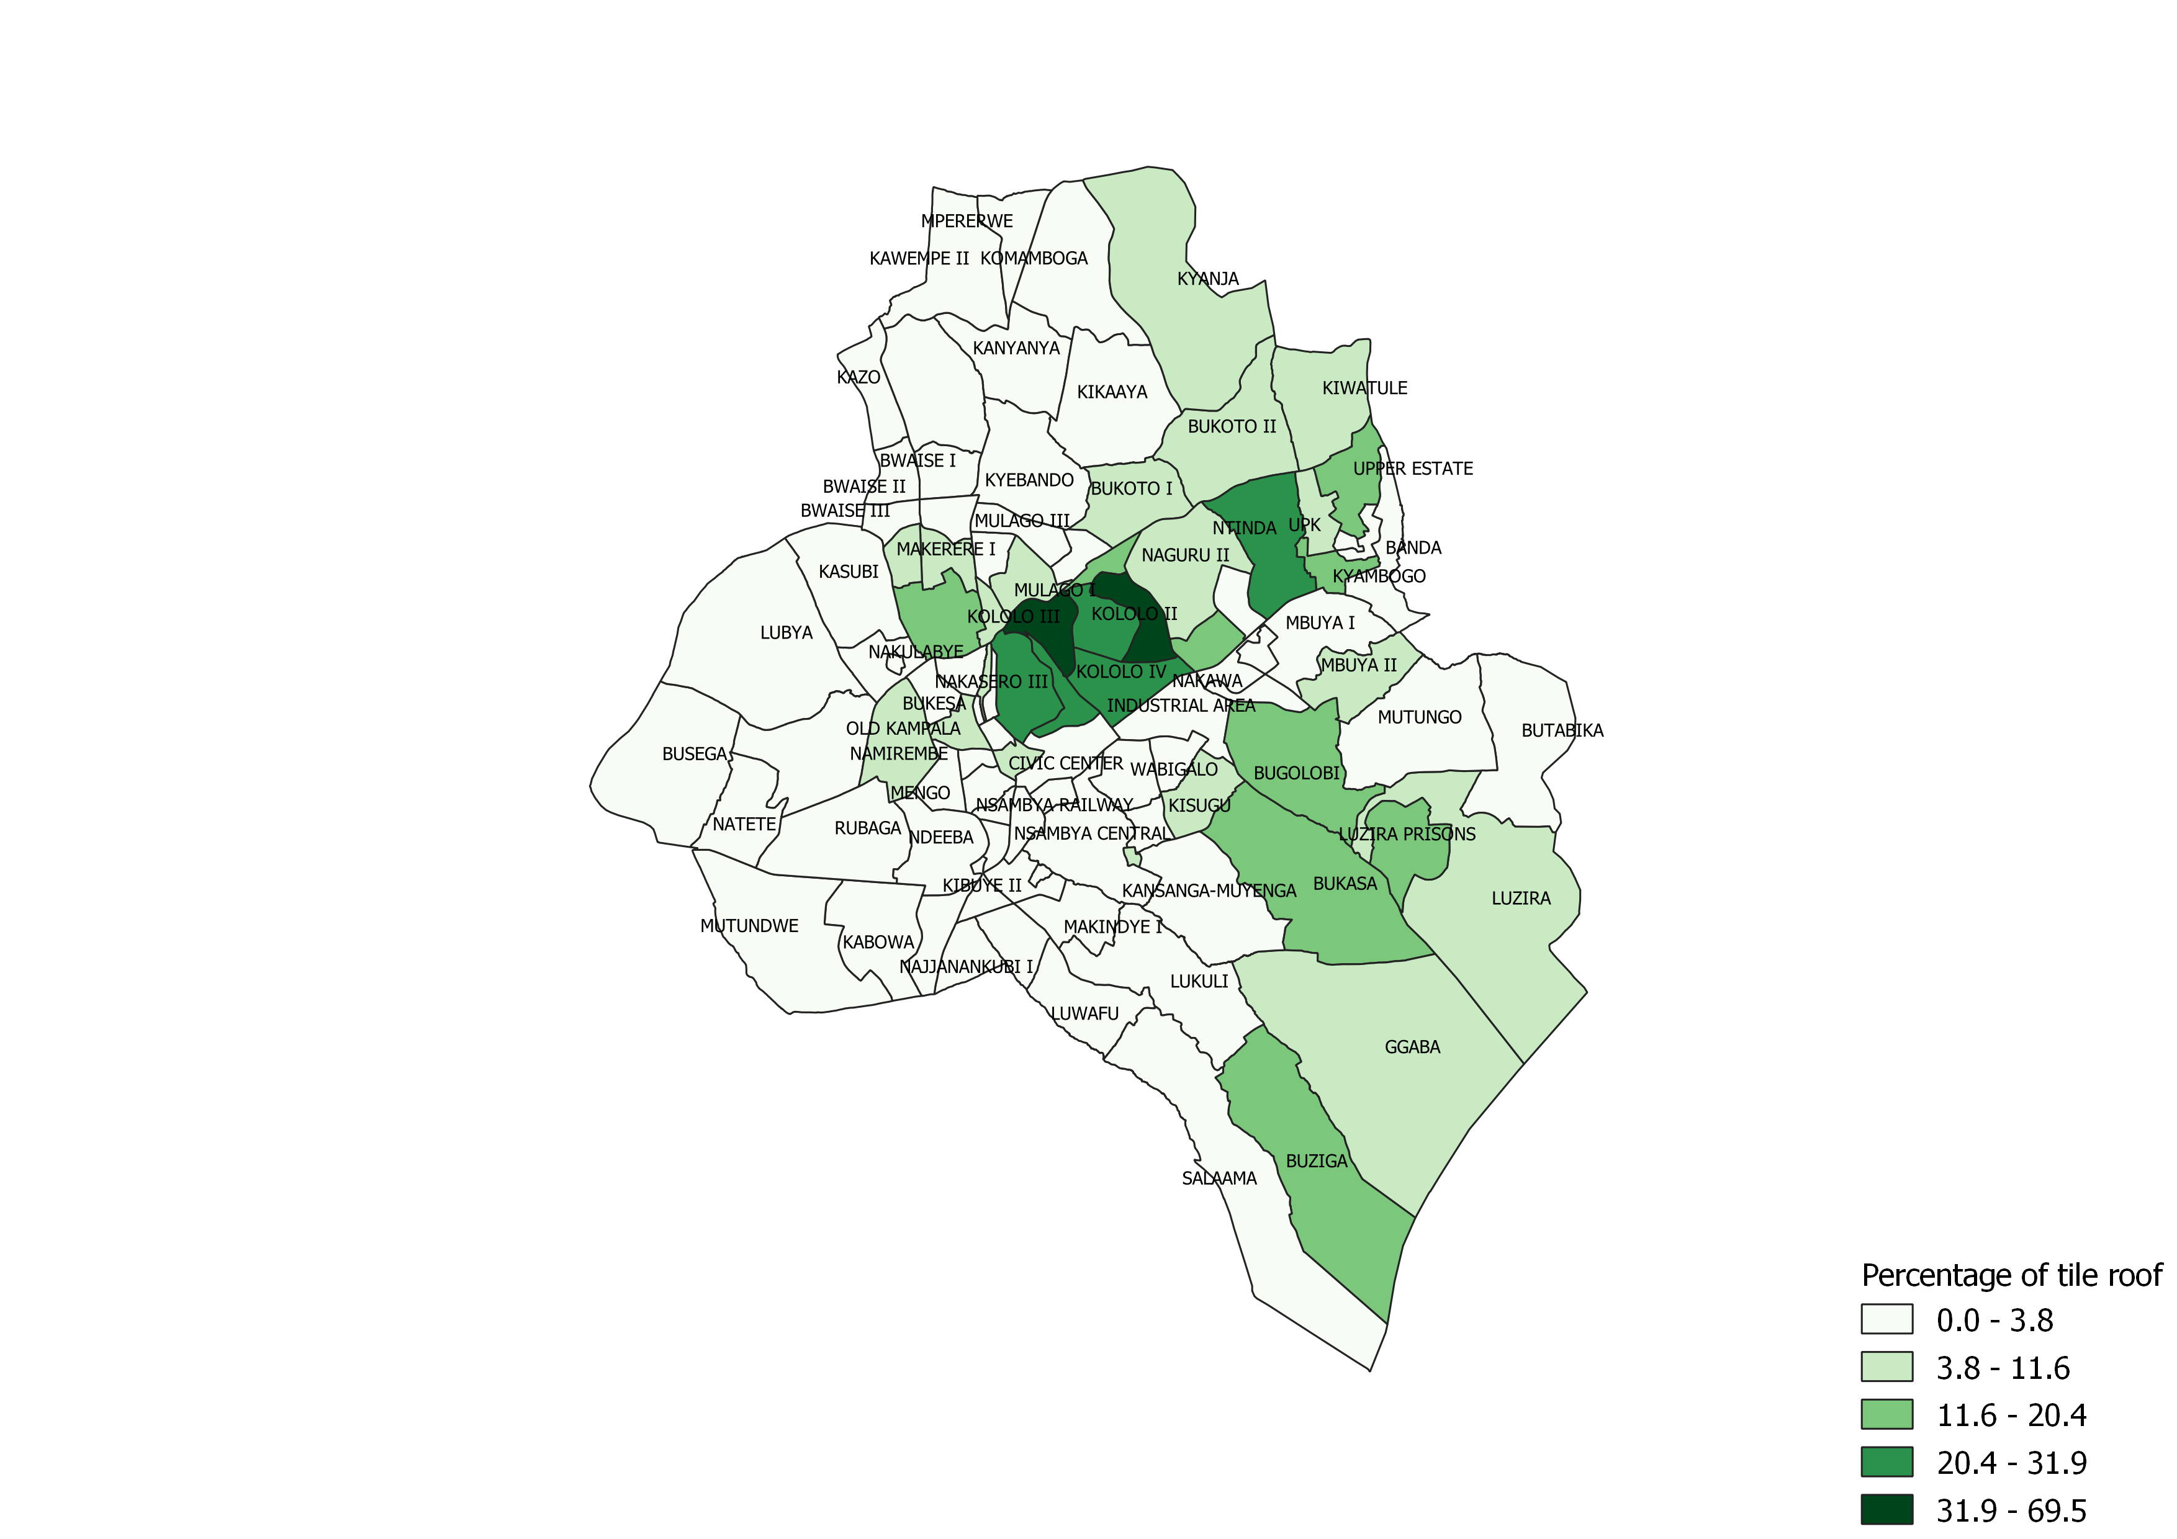
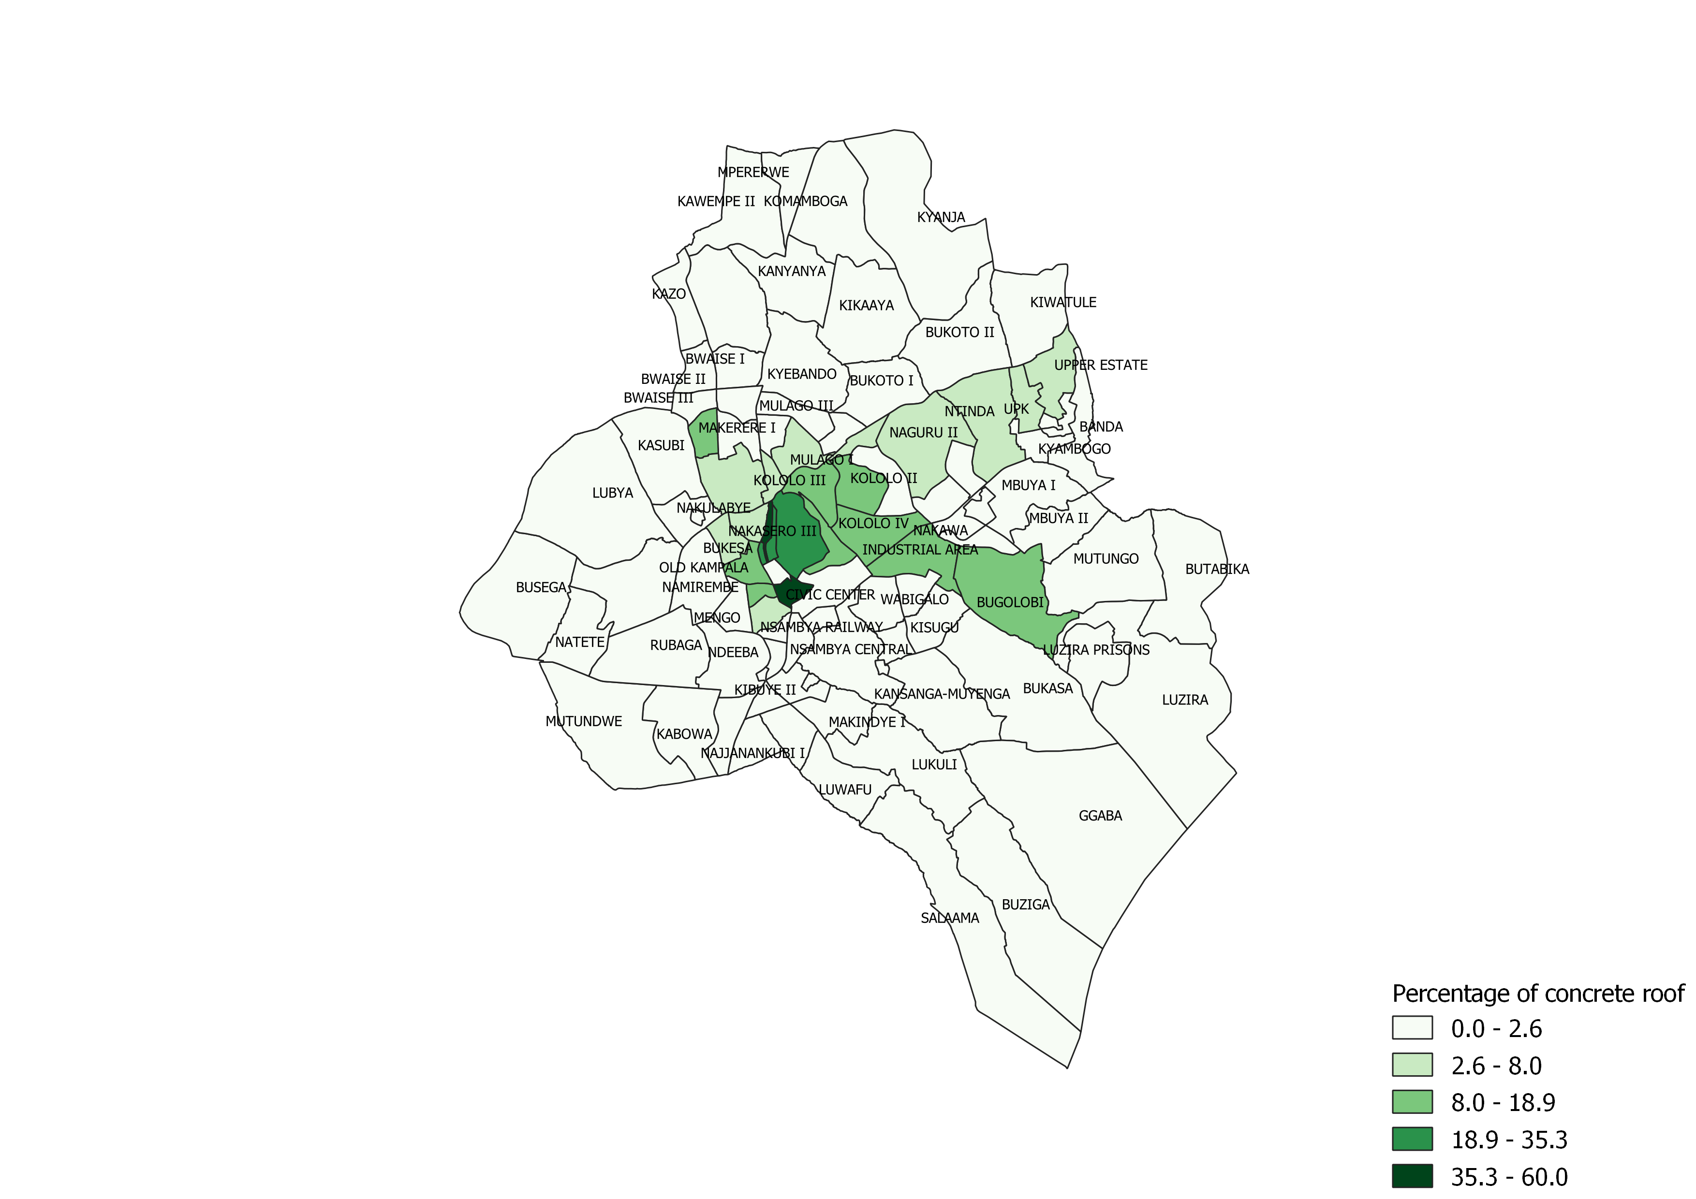
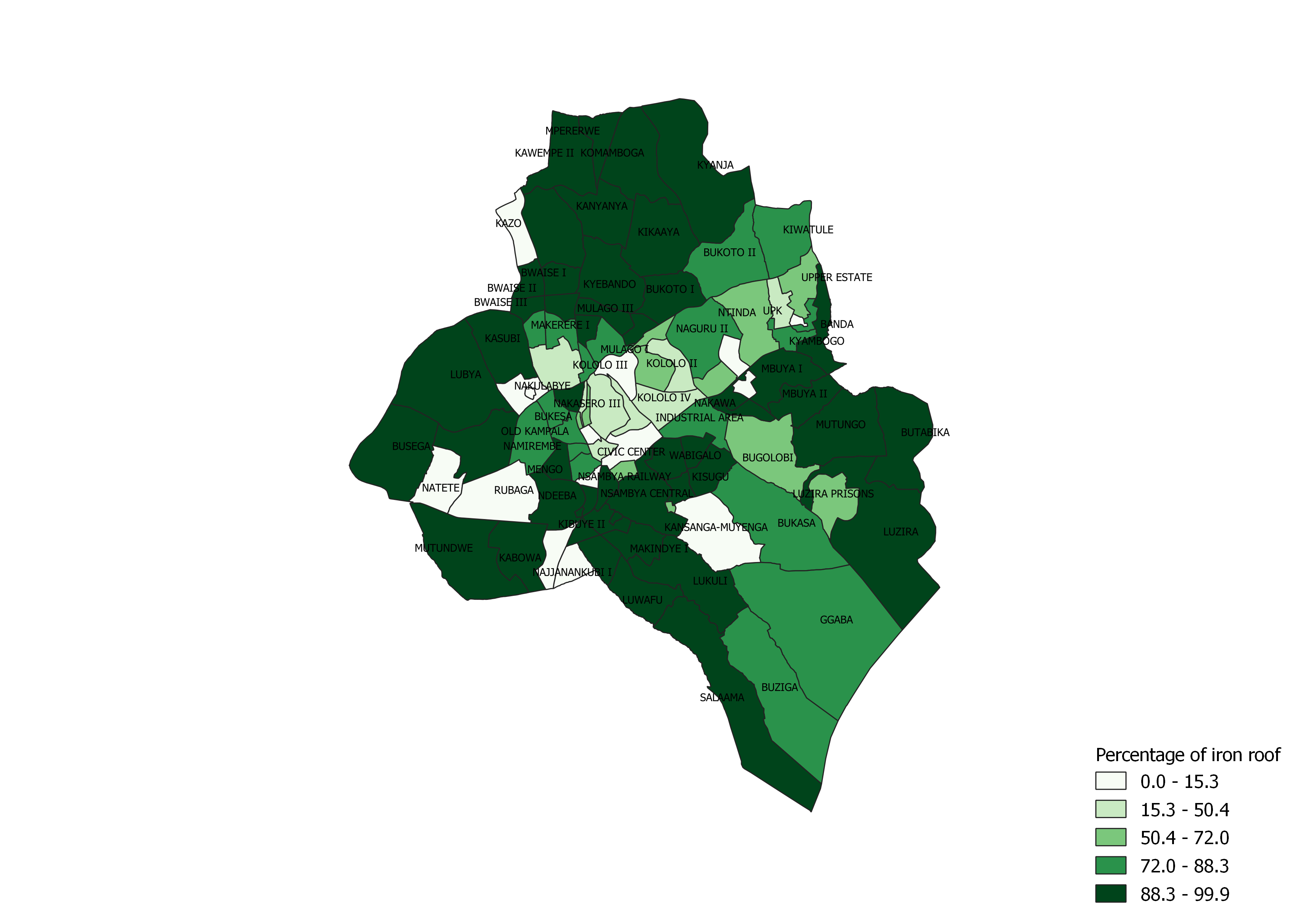
Analysis
Combination of existing data, combined with collected data

Slide 10
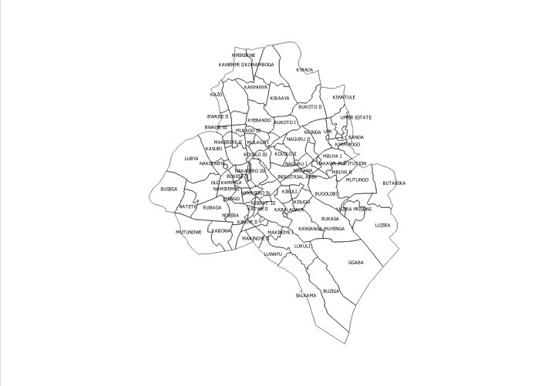
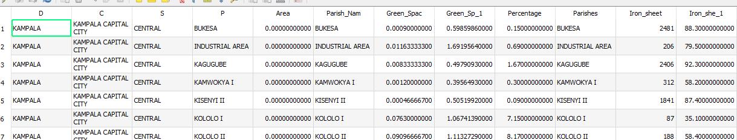
Collected data
Existing data

Slide 11
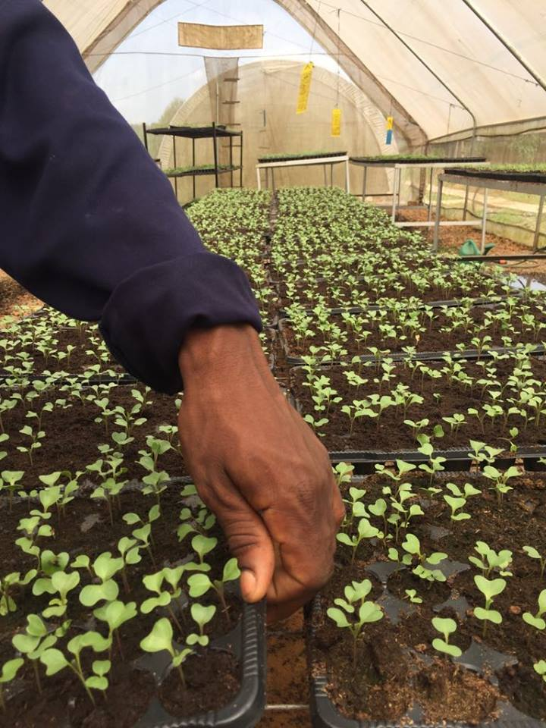
Thank you
Further feed back?

